Slide 1
Various combinations of on-premise and cloud solutions to high availability and disaster recovery

Slide 2
Spectrum between High Availability and Disaster Recovery
It is not an all or nothing proposition
Different degrees of on-premise versus cloud solutions
Four Examples
Backup and restore
Pilot light
Fully working low capacity standby
Multi-site hot standby

Slide 3
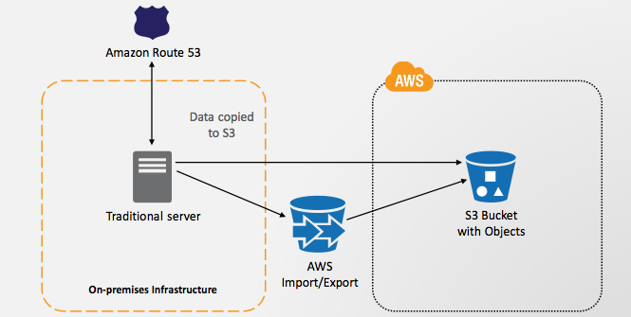
Minimal Cloud: Backup and restore
Run everything on premise
Back up data into S3 buckets in AWS

Slide 4
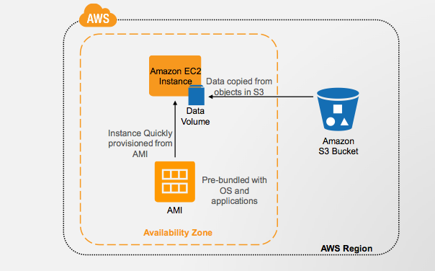
Minimal Cloud: Backup and restore
When on-premise system goes down start restore
During restore
Create AWS instances
Restore data from S3 bucket

Slide 5
Minimal Cloud: Backup and restore
Low usage of cloud solution
Low AWS cost
Slow at recovery
Need to spin up instances and extract data from S3

Slide 6
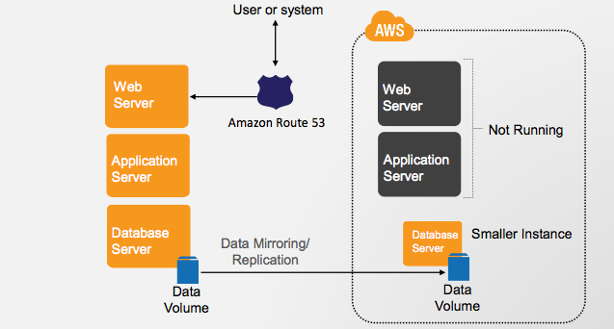
Pilot Light
Run everything on premise
Replicate onto a database server on AWS
Create the standby servers on AWS but do not have them actively running

Slide 7
Pilot Light
Faster during recovery since database is active and contains most up-to-date data
More costly than backup and restore since
Need to keep an active database
Standby non-active servers (need to pay for storage cost on EBS)

Slide 8
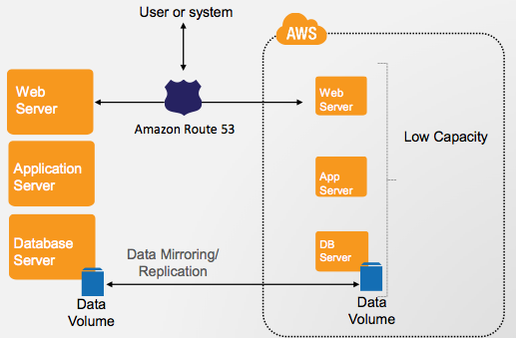
Fully-working Low Capacity Standby
Use route 53 to split workload between on-premise and AWS
Majority of workload on-premise (say 90%)
Putting 10% on AWS means we are constantly testing the AWS servers to make sure they are working correctly.

Slide 9
Fully-working Low Capacity Standby
If on-premise system goes down we can quickly fail-over to the active standby system on AWS
Just need to quickly increase number of servers on AWS
More costly than previous solutions in terms of cloud costs, however, it reacts much better during system failure

Slide 10
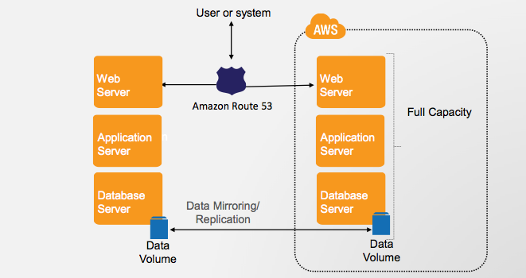
Multi-Site Active-Active
Give 50% of the workload to AWS and 50% to on-premise system
AWS system gets tested very thoroughly and constantly
Best solution for handling failure
More cost on AWS

